Slide 1
Human-governed multi-agent educational operating system for scalable AI teaching
‘人为’主导下multi-Agent驱动的educational OS生态

Slide 2
当前教育生态痛点
教学内容层：
Content generation效率低下
内容时效性差 - Easily outdated -(挖掘新事物的能力 人 < AI)
学生层：
无student实时status监控 -(无法发现问题)
无evolving feedback loop -(及时发现也无法高效的解决问题)
系统层：
单点依赖: high pressure on professor (教授=single agent)
整体纯静态。(无‘生态感’)
内容与考核: 耦合度低，无强关联，难以促进学生长期投入

Slide 3


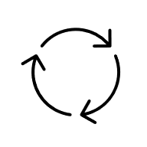

The Vision: 搭建Agent主导的self-evolving教育生态
解决‘单点依赖‘问题
动态知识储备，确保不再出现outdated info
大幅提升教学内容生成的效率
建立对学生学习状态/收益的实际监控
Core Design Logic
Human-governed autonomy
Knowledge-first architecture
Agents execute by default; humans retain final authority.
All major actions are grounded in structured knowledge.
Closed-loop adaptation
Traceable & bounded control
Student evidence can trigger remediation, reteaching, and revision proposals.
Permissions, approvals, and revisions are logged and versioned.

Slide 4
From Linear Delivery to an Evidence-Driven Closed Loop
当前的‘linear workflow’
Proposed workflow：
Syllabus
Content Generation coursework
Student Learning
Intake
Governed Knowledge Setup
Student Learning
Content Generation
Exam
Marking
Signal Collection
Analytics & Adaptation
Exam
Marking
Proposed improvements：
建立学生值得长期‘soak in’的生态 (强&及时交互)
抓取Student Performance Evidence
根据evidence进行整改
接轨外部知识
The system no longer ends at delivery;
learner evidence becomes an operational input.

Slide 5






Weekly routine
规则制定
限制边界
设置长期目标
拟定生态预期
课件生成
Slides, Practical, Coursework, etc.
人&Agents
合作构建初版知识库
知识库
学生
静态知识，动态新闻，学生表现(整体)
CW
学习课件
做题
提供实时表现
个人专属
Agent tutor
修订者
分析/复盘
原始行为‘信号’
对知识库内容做增删改查
将信号转换为 Agent们的 -
- Following operational decisions
Final Marking

Slide 6
Human Governance layer
Knowledge Bank Layer
Teaching Team
Human Governors
Student/Cohort Signal - errors - misconceptions - mastery gaps - learning patterns
knowledge
Frontier knowledge
Archived / deprecated
- syllabus
- learning outcomes
- policy constraints
- approve key updates
- set strategic teaching priorities
- supervise curriculum direction
- Approved core
-stable teaching
-official content
- Latest discovers
- Pendings
- candiate items
-outdated,not fully deleted
-historical memory
Content generation Layer
Orchestration Layer
Curriculum agents
Evolution agents
Quality / Audit agent
Council
Task Manager
Lecture agent
Practical
Coursework
Rubric
Marking
Explorer agent
Bank cleaner
Trend monitor
Update proposer
Alignment checker
Assessment auditor
Hallucination check
Risk / gap
Pedagogical QA
- Set cores
- Review subagents’ proposals
- Decide in&outs
- design tasks
- assign subagents
- assign skills & supportive skills
Student Interaction Layer
Analytics / Feedback / Adaptation Layer
Students
Personal Advisor Agent
collect student performance and interaction traces
detect weak topics, failing practicals, common misconceptions
produce cohort-level and curriculum-level insights
trigger proposals for re-teaching, content revision, or KB update
send evidence back to Governor Council and Orchestrator
Learn
Ask question
Perform practical
Submit work
Help system evolve
one advisor per student - tracks progress, weaknesses, pacing
- personalizes explanations, practice, remediation - reports aggregated signals upward

Slide 7
Departments & Responsibilities
1. Human Governance Department
设计policy, approve大型修改, 部署早期需要一定人工‘运维’
2. Orchestration Department
构建workflow, route tasks. Enforce agent’s permission
3. Knowledge Bank Department
存储, 补丁, 教材根基, 长期记忆
4. Curriculum Production Department
生成教材, 设计考核(draft), feedback artifacts
5. Evolution Department
监视外部(e.g. web, arxiv, github repo)知识迭代，提出补丁方案/内容
6. Quality and Audit Department
正式将教案release之前，检查curriculum product correctness, fairness, etc.
与Governance ‘方针’的alignment
7. Student Advisory Department
个人advisor agent, 长期记忆, 独立于其他agent (遵守governance rules)
8. Analytics and Adaptation Department
将‘信号’ (e.g. click, errors etc.)转化为实质性的建议(more numerical examples…)

Slide 8
End-to-End Operational Workflow
1. Intake. 需要人为强监管
大纲，learning outcome， 教学结构(周)，如何测验，学术铁律，etc.
2. Governance initialization
根据intake建立详细教学计划
3. Knowledge preparation.
建立初版的知识库
4. Curriculum production.
生成课件(pptx,practical code, pdf, etc)
5. Quality and alignment audit.
检查课件，确保不偏离大纲，不违反规则
6. Human approval gate.
人需要核对high impact outputs例如coursework设计
7. Student delivery.
在学习，practice和individual tutor互动的过程中提供宝贵数据
8. Signal collection.
Analytics layer收集分析学生的表现，给出改动建议(知识库&content creator)
9. Adaptation.
Individual tutor做个性化推荐，根据‘改动建议’优化教案
10. Knowledge evolution.
知识库的增删改查
11. Regeneration.
进行有必要的outputs改动 (e.g. 调整后续教学风格，调整当前生成的coursework设计,etc. )

Slide 9

How the System Actually Self-Improves
Regeneration
Approved changes update knowledge or regenerate targeted teaching asset
Student Behave
Feedback ingestion
Student traces, quiz results,
advisor summaries, interaction events
Adaptation
Trigger remediation, extra practice, re-teaching proposals,
content rewrite proposals
Analytics
Detect weak topics,
misconception clusters,
pacing issues, failing practicals
Learner evidence is converted into operational decisions.

Slide 10
Governance and Permission Boundaries
1. Agents do not directly change canonical knowledge
They can propose, but governance approves high-impact writes.
2. Released assessments remain protected
Official coursework and grading rules require human review.
3. Separate personal info from course-level knowledge
Only aggregated cohort signals can influence module-level revision.
Level 0 - Read only: | Can retrieve knowledge, logs, and reports but cannot write any state.
Level 1 - Propose only: | Can create update packets, revision requests, and flagged issues, but cannot mutate protected stores.
Level 2 - Restricted write: | Can update low-risk operational state such as job status, advisor notes, or temporary remediation plans.
Level 3 - Governance-approved write: | Can update canonical knowledge, released curriculum assets, or official assessment rules only after an approval token is issued by governance.

Slide 11
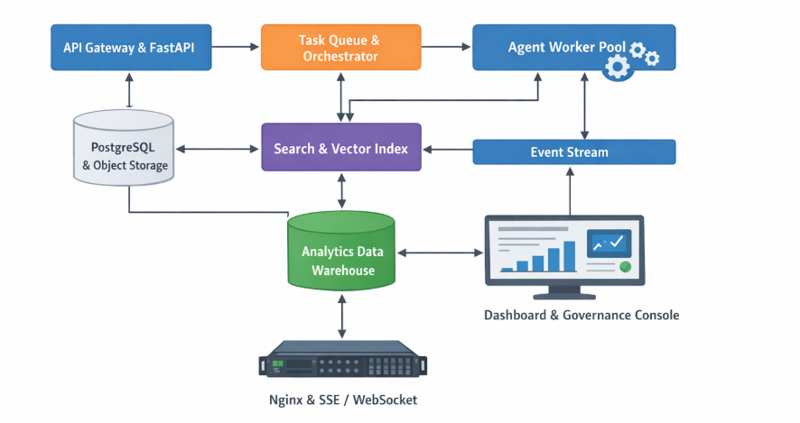
Technical Runtime and Deployment

Slide 12



MVP scope
Start narrow, prove trust, then scale across modules.
First rollout scope
One AI module
One academic term
Syllabus ingestion
Lecture and practical generation
Rubric generation
Student advisor support
Analytics dashboards
Governance approvals
Still human-supervised at first
Official coursework release
Fully automated marking
High-risk canonical knowledge updates

Slide 13
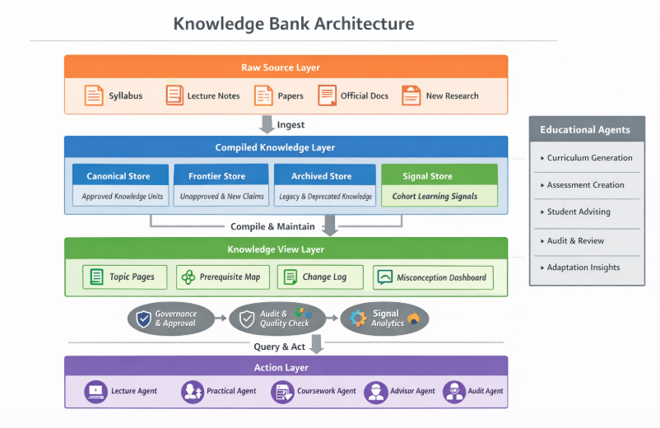
核心难点：知识库的搭建&维护

